Slide 1
Creating Educational Space Content
ASU Interplanetary Initiative - Space For Humans -
James Moore

Slide 2
What is Space For Humans?.

Slide 3
How do we make space more
Inclusive?.
Asking: what is inclusivity?
Researching current methods and programs
Designing ways to express those ideas
Informing Others

Slide 4
Transmissions.
Full Episodes
Shortform
Student Driven
Focus on space and its effects on life on earth
Longform
Team Driven
Focus on Inclusive Design

Slide 5
The Team.
Eric Stribling (Interplanetary Initiative) - Team Lead
Ricardo Leon (EdPlus) - Video Producer
Amanda Kehrberg (Cronkite) - Lead Writer
Other Team Members.
Wayne Anderson - EdPlus
Matthew Robinson - EdPlus
Dania Wright - SFIS
Liz Blythe-Lee - EdPlus

Slide 6
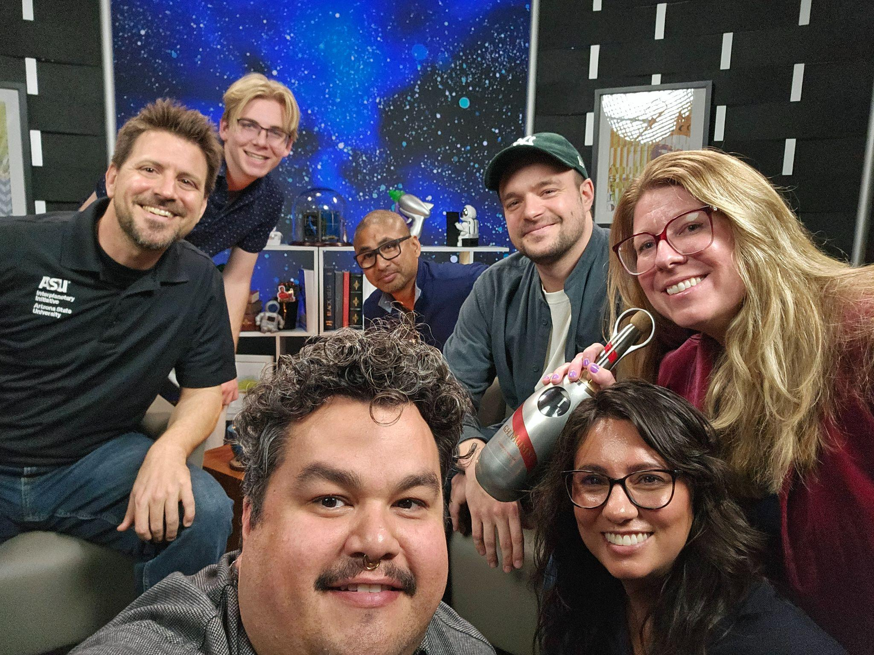
My.
Experience.
Nasa Space Grant Intern
Spare set of hands
DARPA LunA-10

Slide 7
What Makes A Video?.

Slide 8
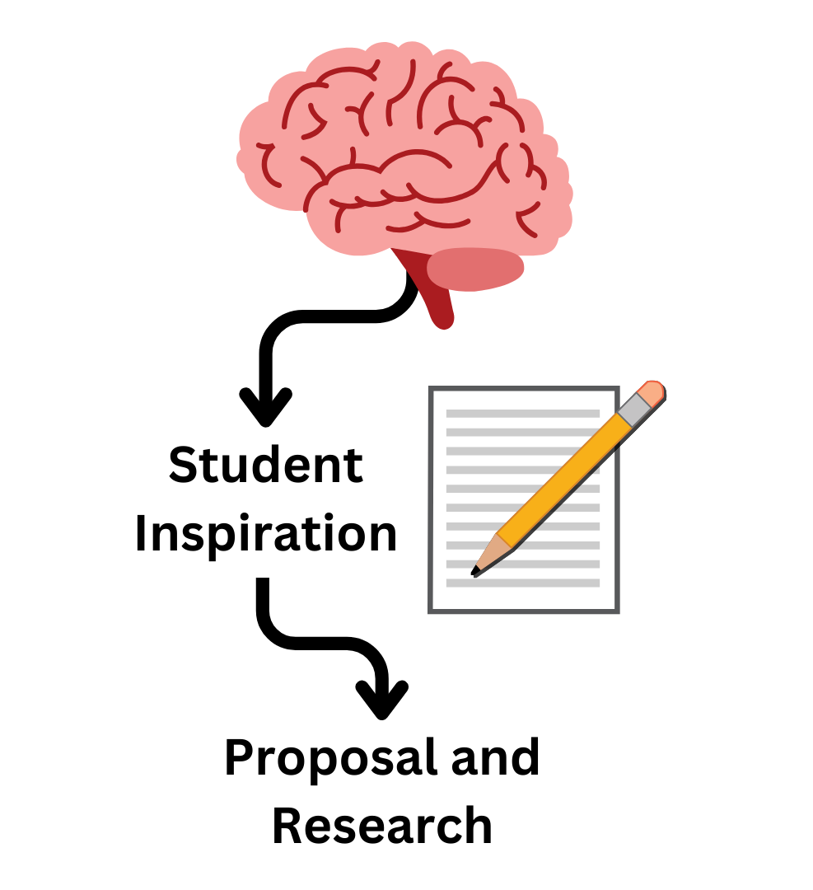
Start with.
Curiosity.
Take note of Interesting concepts
Research what you like the most
Submit a Proposal

Slide 9

Research &.
Review.
Work with Students to:
  Develop and refine their idea
  Create a workable draft

Slide 10
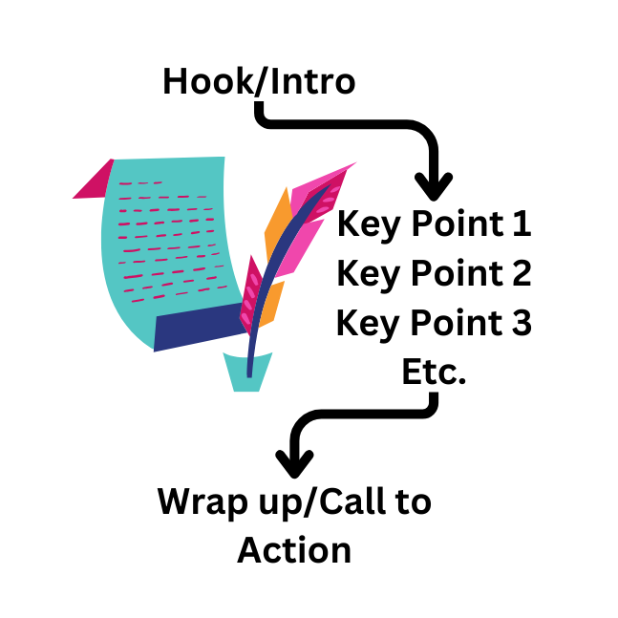
Drafting.
Follow a specific focus throughout the script
Create an easy to interpret stream of information

Slide 11
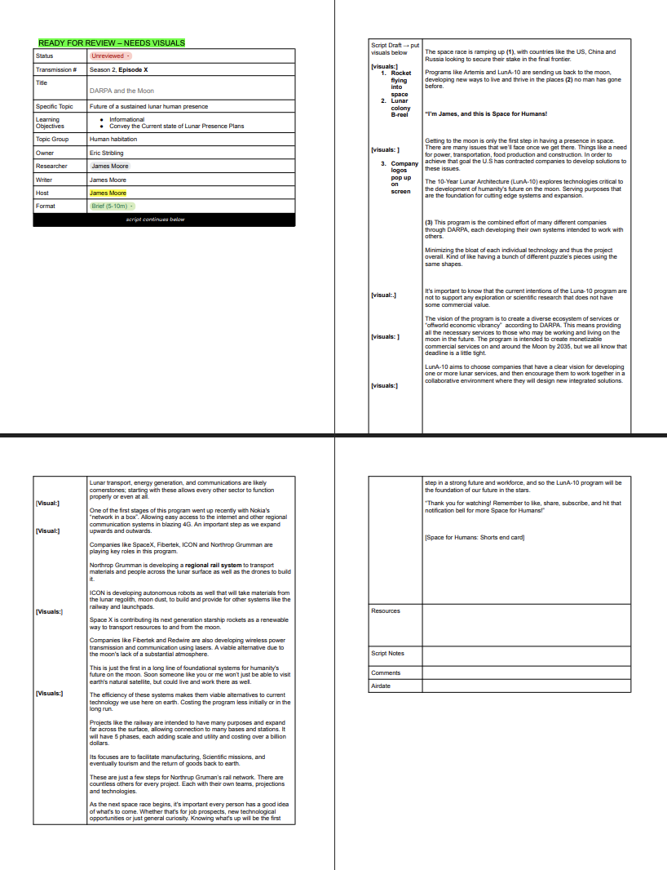
Finalize.
in a.
Template.

Slide 12
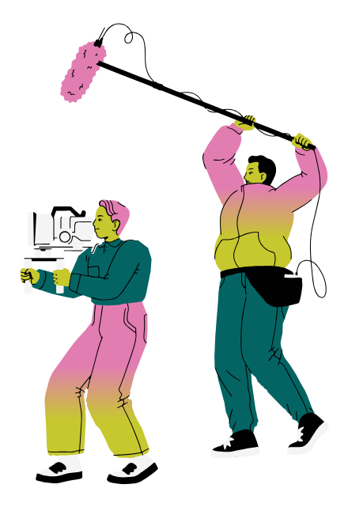
Recording/ Editing
Convey Positivity and Energy to keep the audience engaged.
Make sure to keep vocabulary simple and accessible when need be.
Keep cuts, edits and B-Reel snappy and engaging.

Slide 13
Thank you

